Slide 1

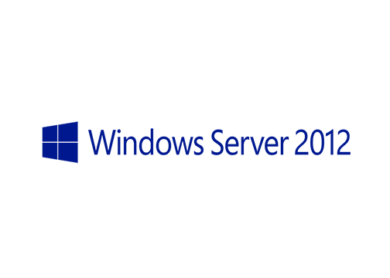
MegaSeries
Demote a Windows Server 2012 Domain Controller

Slide 2
Steps
Demote the Domain Controller
Remove server from domain
Delete the virtual machine from Hyper-V (be careful to delete also the disk)
Configure the DNS servers on the remaining Domain Controllers

Slide 3
https://www.youtube.com/channel/UCcZ-jLbPwNr8E_v9-65n8Iw https://github.com/itknowledge4

